Slide 1

Swift Park
You choose we advice

Slide 2
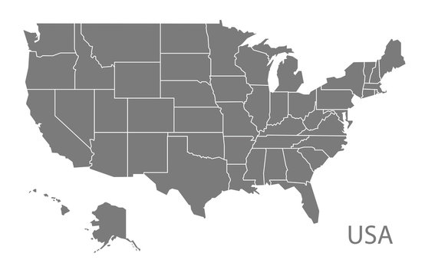
Problem
Lack of Information
Time Consuming
Decision making
Swift Park
Chicago
56 hours
NYC
107 hours
San francisco
83 hours
Washington DC
65 hours
LA
85 hours
Atlanta
50 hours

Slide 3
OUR SOLUTION
Swift Park
Mobile application for:
Parking in advance
Parking on the fly

Slide 4
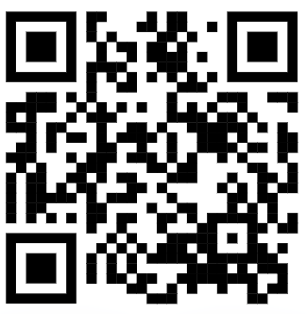
DEMO SOFTWARE & APP
Swift Park

Slide 5
TARGET AUDIENCE
Swift Park
URBAN DWELLERS
People living in cities who rely on cars for commuting and face parking challenges
EVENT ATTENDEES
WORKING PROFESSIONALS
Individuals attending events, concerts, sports games, or other gatherings who need accessible parking options.
Professionals who commute regularly and seek convenient parking solutions near workplaces.

Slide 6




Competitors
Features | Swift Park | Park mobile | Way - Auto Super app
Parking reservation
Compare parking prices
Look for street parking
Give suitable options for users
Customer satisfaction

Slide 7
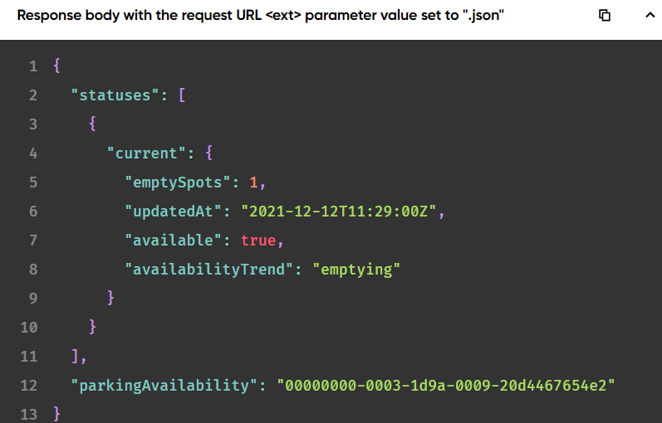
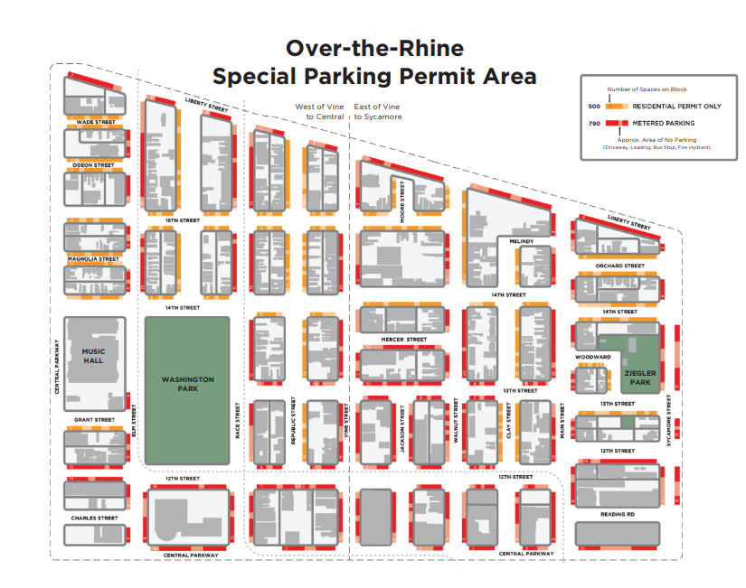
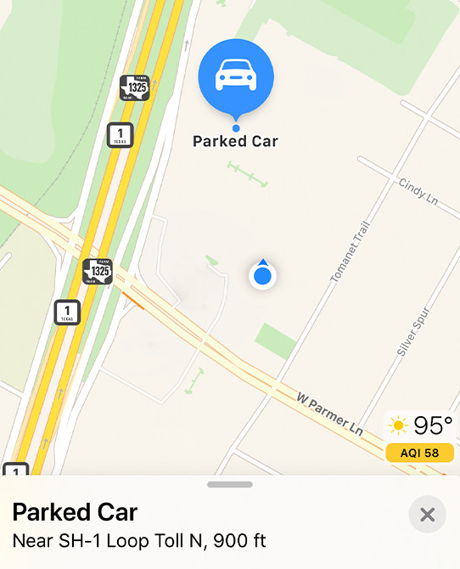
Data Acquisition
Swift Park
1
Free APIs
2
City Maps
3
Gather our own data
4
Partnership with companies

Slide 8
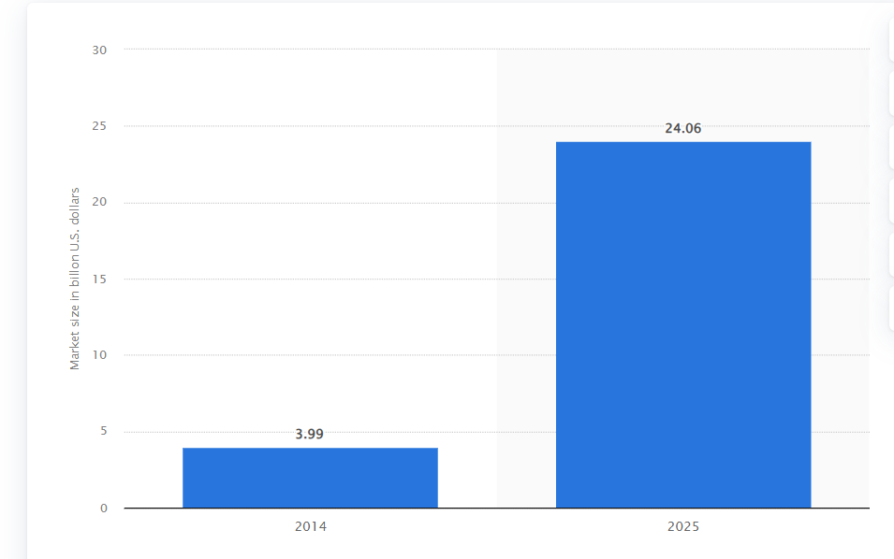
Market size
Swift Park
According to Statista in 2025, the North American smart parking market is expected to generate around 24 billion U.S. dollars in revenue.

Slide 9
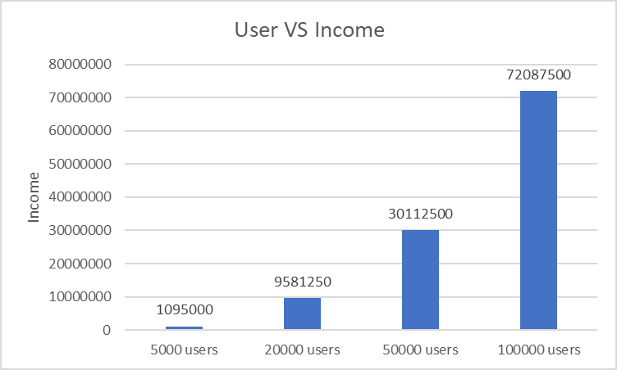
Projected Revenue
Swift Park
Estimated First user = 5000 users
Estimated Active user = 3000 users
1500 users use our app on daily basis
Revenue Source
Subscription fee = $2.5 / month
Ads Revenue = $2
Income from our 1st daily active users = 1500 x 2 = $3000 /day
Total income in a year = 3000 x 365 = $1,095,000 / year
Over year our users keep on increasing along with the subscription and the value are displayed in the chart

Slide 10
PROFITABLE GROWTH
Swift Park
PHASE 1
PHASE 2
PHASE 3
PHASE 4
Gather data
Expand
Partner with private parking lots
Expand into downtown
UC campus and vendors around have great data to collect
Expanding beyond surrounding streets of campus with collected user data

Slide 11





OUR TEAM
Sambhav Poudel
Samir Idris
Vijay Kumar Virigineni
Swift Park
Computer Science
Computer Science
Information Technology

Slide 12
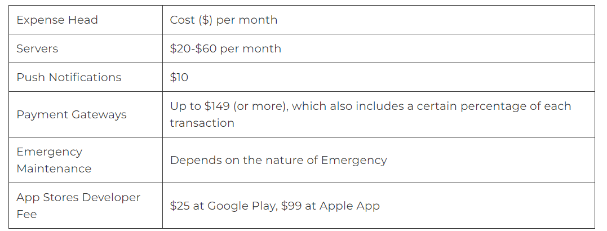
Cost for Storing Data
Swift Park
Cost for storing 1GB data in Amazon = 0.0125 per month
For our First Users
Lets’ say 5000 users
To store Users information along with latitude and longitude
We need around 10 GB. Cost in month = 10 * 0.0125 = $ 62.5 per month
Cost in year = 62.5 * 12 = $750 per year
$70k for each developer

